Slide 1
Heating and Cooling
Kinetic Theory
Conservation of Energy
Specific Heat Capacity
Method of Mixtures
Latent Heat
Heat Transfer

Slide 2

SCSA ATAR Syllabus (up to date as of 14/11/17; https://senior-secondary.scsa.wa.edu.au/syllabus-and-support-materials/science/physics)
Science Understanding
the kinetic particle model describes matter as consisting of particles in constant motion, except at absolute zero
all substances have internal energy due to the motion and separation of their particles
temperature is a measure of the average kinetic energy of particles in a system
provided a substance does not change state, its temperature change is proportional to the amount of energy added to or removed from the substance; the constant of proportionality describes the heat capacity of the substance This includes applying the relationship
$$Q=mc∆T$$
change of state involves separating particles which exert attractive forces on each other; latent heat is the energy required to be added to or removed from a system to change the state of the system This includes applying the relationship
$$Q=mL$$
two systems in contact transfer energy between particles so that eventually the systems reach the same temperature; that is, they are in thermal equilibrium. This may involve changes of state as well as changes in temperature
a system with thermal energy has the capacity to do mechanical work [to apply a force over a distance]; when work is done, the internal energy of the system changes
because energy is conserved, the change in internal energy of a system is equal to the energy added by heating, or removed by cooling, plus the work done on or by the system
heat transfer occurs between and within systems by conduction, convection and/or radiation
energy transfers and transformations in mechanical systems always result in some heat loss to the environment, so that the usable energy is reduced and the system cannot be 100 percent efficient This includes applying the relationship
$$efficiency η=\frac{energy output}{energy input}×100\%$$
Science as a Human Endeavour
The development of heating technologies that use conduction, convection, radiation and latent heat have had, and continue to have, significant social, economic and environmental impacts. These technologies include:
passive solar design for heating and cooling of buildings
the development of the refrigerator over time
the use of the sun for heating water
engine cooling systems in cars.

Slide 3
Fundamental concepts
Temperature: a measure of the average particle kinetic energy of a substance
Particle kinetic energy: the kinetic energy associated with the small scale random vibration/movement of particles
Internal energy: the sum of particle kinetic energy and potential energy held by a substance
Heat: the flow of internal energy from one object to another to achieve thermal equilibrium (from a higher temperature object to a lower temperature object)
Thermal Equilibrium: two objects are in thermal equilibrium if they are at the same temperature i.e. if there is no net flow of energy between them
Our bodies are not sensitive to temperature as such, they detect the flow of energy in to or out of them

Slide 4


Temperature scales
Celsius
Kelvin
0$℃$ is the freezing point of water
100 $℃$ is the boiling point of water
STP is at 0$℃$
0K is the lowest temperature that can theoretically exist
1K is the same size increment as 1$℃$
STP is at 273K (273.15K)

Slide 5
Kinetic theory Assumptions
All matter is made of many very small particles (atoms or molecules)
Particles are in constant motion
Forces of attraction and repulsion exist between the particles, potential energy is stored in the intermolecular bonds (springs)
The distance between particles in a gas is very large compared to the size of the particles
Collision between particles and with the walls of the container are perfectly elastic (no loss of E_{K})

Slide 6
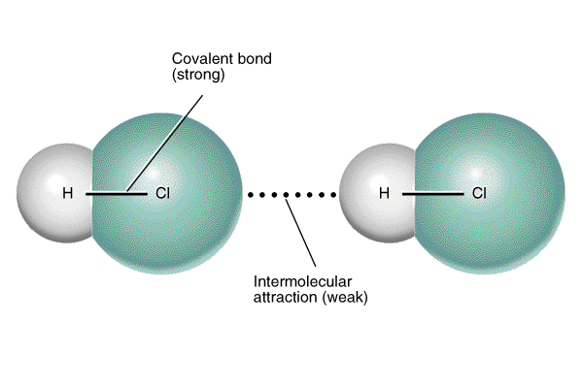
Intermolecular forces

Slide 7
States of Matter

Slide 8
Particle and Kinetic Theory
Substances are made up of particles. The state of the substance depends on the arrangement of the particles.
The Three States of Matter
Solid
Particles held tightly
Very close together
Regular arrangement
Vibrate
Can’t move from place to place
Liquid
Moderate force
Very close together
Random arrangement
Vibrate
Constantly move past each other
Gas
No attraction between particles
Far apart, colliding with walls
Random arrangement
Move quickly in all directions

Slide 9
Fluids as moving particles
Particles with only very weak attractions between them can be seen behaving like a liquid when “weightless”
Some very weak surface tension present
Liquid sand hot tub (Rober, M. 2017)

Slide 10
Brownian motion
Chaotic motion of minute particle suspended in a gas or liquid.
Grains of pollen in water.

Slide 11
Compression and expansion of gas is accompanied by its heating and cooling.

Slide 12
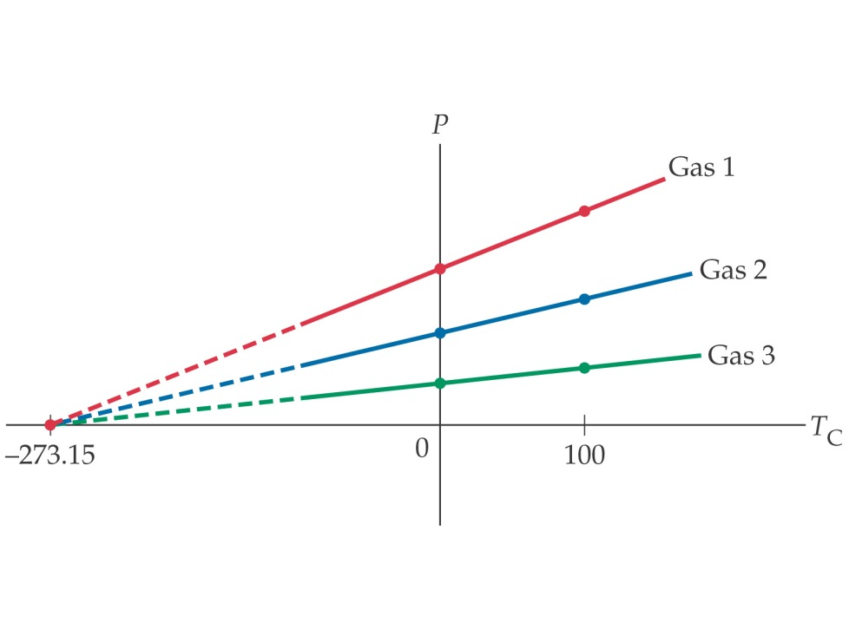
Absolute zero
At absolute zero particles have 0 kinetic energy
Any gas reduced to absolute zero exerts zero pressure on its surroundings
Particles cease moving completely

Slide 13
Thermal Expansion
As a substance is heated it gains thermal (kinetic) energy as the particles vibrate/move faster
It also gains potential energy as the faster moving particles stretch the bonds between particles moving further apart
As the particles all move slightly further apart the substance expands

Slide 14
Conservation of energy
Energy can neither be created nor destroyed.
Energy can be transferred or transformed but the total energy of an isolated system remains constant.
Net change in energy is 0.

Slide 15

Internal energy (U)
The energy contained within a system
It excludes the kinetic energy of motion of the system as a whole and the potential energy of the system as a whole due to external force fields.
∆U rather than absolute values
$$∆U=Q_{in}−Q_{out}−W_{by}+W_{on}$$
Q_{in} = heat flow into the system
Q_{out} = heat flow out of the system
W_{by} = work done by the system
W_{on} = work done on the system
Mostly represents the sum of thermal energy of a substance and the potential energy stored in stretched bonds in the substance

Slide 16

Examples
A 1l beaker of water has 25 k J of work done on it and also loses 30 k J of thermal energy to the surroundings. Determine the change in energy of the water.
$$∆U=−30000+25000$$
$$∆U=−5000J$$
A heating element in a paddle-wheel apparatus deliver 2530 J of energy to the water and the paddle does 240 J of work on the water. Calculate the change in internal energy of the water.
$$∆U=2530+240$$
$$∆U=2770J$$

Slide 17

POWER
Rate of energy transfer/transformation.
Rate of work.
Joules/second or Watts
$$P=\frac{W}{t}=\frac{∆E}{t}$$
Often applied in conjunction with efficiency
$$efficiency (\%)=\frac{useful output}{total input}×100$$

Slide 18

Example 1
A car produces 570 kJ of energy from combusting petrol with air. Only 190 kJ of useful mechanical energy was delivered by the car.
Show the energy transformation as a flow diagram.
b) What is the car’s efficiency?
$$efficiency \left(\%\right)=\frac{190000}{570000}×100=33.3\%$$
570 kJ
Car
190 kJ
380 kJ waste

Slide 19

Example 2
Determine the amount of light energy delivered by a 60 W incandescent globe that is switched on for 45 minutes. The efficiency of the globe is 3.0%
$$t=45×60=2700s$$
$$E_{input}=60×2700=16200J$$
$$E_{output}=16200×0.03=4860J$$

Slide 20
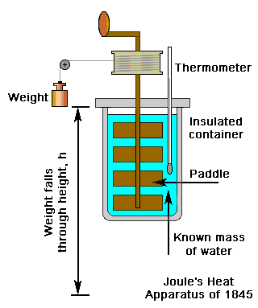
Joule’s paddle wheel
Falling mass turned paddle
Potential energy of mass converted to kinetic energy of paddle converted to heat energy of water
Repeatedly dropping the mass leads to measurable increases in T

Slide 21
Which will heat up faster?
Small beaker full of water/large one? Why?
Beach sand/ sea? Why?
Amount of heat (Q) required to cause a rise in temperature depends on:
Mass of object
Type of material
Temperature increase

Slide 22
Specific Heat Capacity
Specific to a substance
Amount of energy required to raise the heat of 1 kg of the substance by 1 degree (C or K)
Highest element: c(H_{2(g)}) = 14300 J kg⁻¹ K⁻¹
Lowest element: c(Tc_{(s)}) = 63 J kg⁻¹ K⁻¹

Slide 23
ΔQ = m c ΔT
ΔQ = m c (T_{f}-T_{i})
ΔQ = change in energy, energy gained/lost (J)
m = mass (kg)
c = specific heat capacity (J kg⁻¹ K⁻¹)
ΔT = change in temperature (K or ◦C)
T_{f} = final temperature (K or ◦C)
T_{i} = initial temperature (K or ◦C)

Slide 24
Common subtances
Substance | c (J kg⁻¹ K⁻¹)
Water | 4180
Ice | 2100
Copper | 380
Iron | 480
Aluminium | 900
Ethanol | 2500
Paraffin | 2140
Olive oil | 1970
Air | 1000

Slide 25

Example 1
2000g of water at 20$℃$ has a 2kW immersion heater placed in it for 2 minutes. Determine final temperature.
$$Q=mc∆T$$
$$2000×2×60=2×4180×{(T}_{f}−20)$$
$$T_{f}=48.7℃$$
2 kW=2000 W=2 J s⁻¹
In reality the temperature would be lower than this, why?
Heat lost to surroundings
Heat absorbed by vessel and equipment

Slide 26

Example 2
The two disk brakes of a 600 kg motorbike each have a mass of 1 kg. The motorbike brakes to a stop from a velocity of 30 m s⁻¹. If 50 % of the bikes E_{K} is transferred to the brakes; calculate their rise in T (c = 500 J kg⁻¹ K⁻¹)
$$0.5E_{k}=Q$$
$$0.5\frac{1}{2}mv^{2}=mc∆T$$
$$0.5\frac{1}{2}600({30)}^{2}=\left(2\right)500∆T$$
$$∆T=135K$$

Slide 27

Example 3
How much heat is required to raise the temperature of an empty 20kg vat made of iron from 10⁰C to 90⁰C? (c_{iron}=450 J kg⁻¹ K⁻¹)
$$Q=20×450×\left(90−10\right) \\ Q=720 kJ$$
What if the vat was filled with 20kg water?
$$Q=20×450×\left(90−10\right)+20×4180×\left(90−10\right) \\ 7410 kJ$$
mc∆T term for the iron as before
Additional mc∆T term for the water

Slide 28
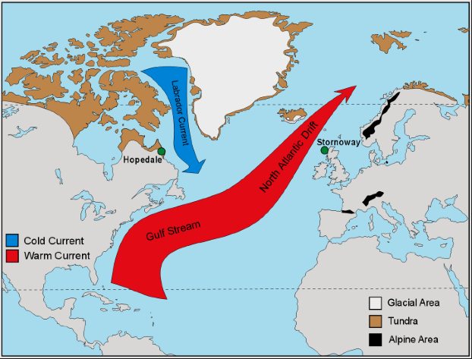
Water: high c
Water has notably high specific heat capacity
Takes a long time to heat up also takes a long time to cool down
Has to absorb a lot of energy to heat up also has to release a lot of energy to cool down
The British Isles are warmer than they should be at their latitude
Caused by warm currents flowing up from the equator known as the Gulf Stream
Large amounts of energy transferred by the water

Slide 29
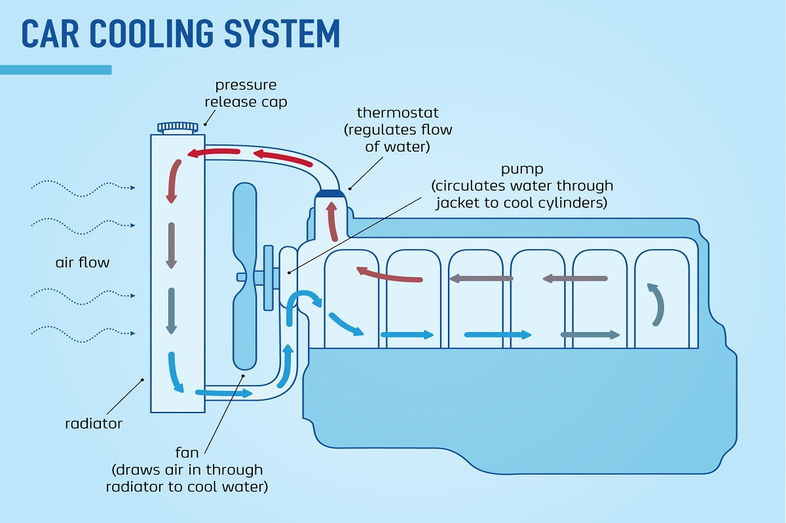
Water cooling systems
In many machines water is used as the coolant (with some additives)
Pumped over hot elements to absorb energy from them then through a component designed to cool the water (e.g. car radiator)
High c so water would have to absorb an enormous amount of energy to boil in the pipes
Can store and transfer large amounts of energy without undergoing phase change

Slide 30

Burns from hot food
Hamish and Andy felt the need to make this song about dangerous food
Why is the filling of a pie so much more dangerous than the crust?
Filling has high water content, which has a high specific heat capacity so it stores a lot of energy and releases a lot as it cools
Crust has little water and a lot of air so it cools down quickly, not having stored a lot of energy
Additionally, pastry insulates the filling preventing heat loss to surroundings

Slide 31
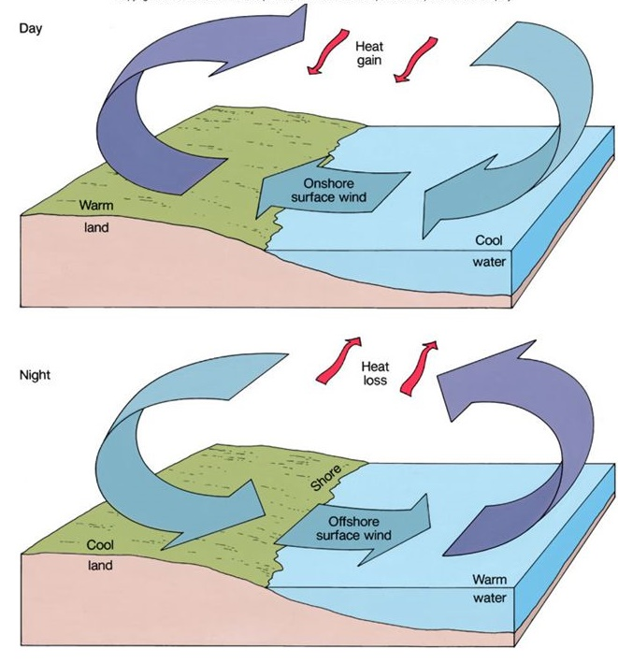
Onshore/offshore winds
During the day, land heats faster than the sea, heats air above it, creating convection currents
Caused by lower specific heat capacity of the land, assuming land and sea receive same energy input, land will increase in temperature more
At night land cools faster than sea, warmer sea keeps air above warmer creating convection currents
Caused by higher specific heat capacity of water, sea stores more energy to release and cools more slowly

Slide 32

Method of mixtures
Can be used to determine specific heat capacity of unknown substances
Combine 2 objects, ensure all heat lost by one object is gained by the other:
$$Q_{lost}=Q_{gained}$$
$$m_{1}c_{1}{∆T}_{1}=m_{2}c_{2}{∆T}_{2}$$
$$m_{1}c_{1}(T_{i1}−T_{f})=m_{2}c_{2}(T_{f}−T_{i2})$$
Initial and final temperatures are different orders just to ensure that ∆T is positive
Assumes that there is no loss of heat to the surroundings

Slide 33

Example
50g of iron is heated to a certain temperature. It is then plunged into 1.0 l of water at 15⁰C. When thermal equilibrium is reached the temperature is 17⁰C. Determine the initial temperature of the iron whose c = 440Jkg⁻¹K⁻¹
$$Q_{lost}=Q_{gained}$$
$$m_{1}c_{1}{∆T}_{1}=m_{2}c_{2}{∆T}_{2}$$
$$0.05×440 (T_{i1}−17)=1×4180(17−15)$$
$$T_{i1}=397℃$$

Slide 34

Example 2
200g of water at 10$℃$ is added to 400g of water at 50$℃$ in a 200g metal container (c = 400 J kg⁻¹ K⁻¹). What will the temperature of the water be after mixing?
$$Q_{lost}=Q_{gained}$$
$$m_{1}c_{1}{∆T}_{1}+m_{metal}c_{metal}{∆T}_{metal}=m_{2}c_{2}{∆T}_{2}$$
$$0.4×4180 \left(50−T_{f}\right)+0.2×400 (50−T_{f})=0.2×4180(T_{f}−10)$$
$$83600−1672T_{f}+4000−80T_{f}=836T_{f}−8360$$
$$87600−1752T_{f}=836T_{f}−8360$$
$$95960=2588T_{f}$$
$$T_{f}=37.1℃$$

Slide 35

Example 3
A calorimeter containing 250mL of water at 25 $℃$ has a 30g lining of aluminium (c = 900 J kg⁻¹ K⁻¹). 150g of copper (c = 390 J kg⁻¹ K⁻¹) at 250 $℃$is plunged in. Determine final temperature.
$$Q_{lost}=Q_{gained}$$
$$m_{Cu}c_{Cu}{∆T}_{Cu}=m_{H2O}c_{H2O}{∆T}_{H2O}+m_{Al}c_{Al}{∆T}_{Al}$$
$$0.15×390 \left(250−T_{f}\right)=0.25×4180\left(T_{f}−25\right)+0.03×900(T_{f}−25)$$
$$14625−58.5T_{f}=1045T_{f}−26125+27T_{f}−675$$
$$14625−58.5T_{f}=1072T_{f}−26800$$
$$41425=1130.5T_{f}$$
$$T_{f}=36.6℃$$

Slide 36

Example 4
120g of an unknown substance is heated to 150 $℃$ and is then plunged into 125mL of water at 25 $℃$. The final temperature is 28 $℃$, find the specific heat capacity of the unknown.
$$Q_{lost}=Q_{gained}$$
$$m_{X}c_{X}{∆T}_{X}=m_{H2O}c_{H2O}{∆T}_{H2O}$$
$$0.12×c_{X} \left(150−28\right)=0.125×4180\left(28−25\right)$$
$$14.64c_{X}=1567.5$$
$$c_{X}=107 J {kg}^{−1}K^{−1}$$

Slide 37
As a solid is heated it increases in temperature
When it reaches the melting point it remains at a constant temperature as it melts
Once it has all melted it continues to increase in temperature as it is heated
When it reaches the boiling point it again remains at a constant temperature as it boils
Once it is all a gas it continues to increase in temperature as it is heated
Where does the energy go?
Temperature
liquid
vaporises
gas
heats
liquid
heats
solid
melts
solid
heats
Time

Slide 38
Explaining the cooling/Heating curve with kinetic theory
T is a measure of average E_{K}
E_{P} is stored in stretched bonds between particles
As the solid gains energy the particles start to vibrate faster and further apart– gain in E_{K} and E_{P} (temp increases + expands)
When it starts to melt, the particles are moving further apart (gain in E_{P}) as bonds are broken. No increase in E_{K} during this stage.
Energy required to melt solid = Energy to freeze it.

Slide 39

Latent heat of fusion/vaporisation
The latent heat of fusion (L_{f}) of a substance is the energy required to melt 1 kg of the substance at its melting point
The same amount of energy must be removed to cause 1kg of the substance to solidify at its melting point
The latent heat of vaporization (L_{v}) of a substance is the energy required to vaporise 1 kg of the substance at its boiling point
The same amount of energy must be removed to condense 1kg of the substance at its boiling point
$$Q=mL$$
Both are measured in J kg⁻¹

Slide 40

Example 1
If an 800 W microwave cooks a cup of water for 1 minute 30 seconds, what will the temperature of the water be? Will any boil away? Start temp = 25⁰C
$$Q=800×90=72000J$$
$$72000=0.25×4180×\left(T_{f}−25\right)$$
$$T_{f}=93.9℃$$
Heat for 2 mins in microwave, how much boils away?
$$Q_{supplied}=800×120=96000J$$
$$Q_{heating}=0.25×4180×\left(100−25\right)=78375J$$
$Q_{vaporisation}=Q_{supplied}−Q_{heating}=96000−78375=17625$J
$$17625=m2260000$$
$$m=0.00780kg$$

Slide 41

Example 2
A 2 kW kettle holds 2L of water at 20$℃$. How long will it be before a quarter of the water has boiled away assuming no heat loss?
$$E=Pt$$
$$Q=mc∆T+mL$$
$$Pt=mc∆T+mL$$
$$2000t=2×4180×80+0.5×2260000$$
$$t=899.4s$$

Slide 42

Example 3
Calculate the heat required to convert 5kg of ice at -20 ⁰C into steam at 100⁰C
$$Q=mc∆T+mL+mc∆T+mL$$
$$Q=5×2108×20+5×334000+5×4180×100+5×2260000$$
$$Q=15270800 J$$
$$Q=15.3 MJ$$

Slide 43
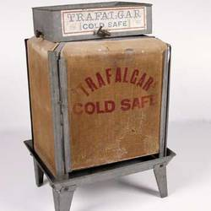
Cooling effect of evaporation
Sweating, panting and Coolgardie safe all use evaporation to cool an object.
As water evaporates the particles that undergo a phase change must absorb the latent heat of vaporisation from their surroundings to break the bonds between particles
As the evaporating particles are absorbing energy from their surroundings it has a cooling effect on the surroundings

Slide 44

Method of mixtures with latent heat
Determine the mass of ice at 0 ⁰C that is placed into a beaker of 250 mL of water at 25 ⁰C if the final temperature reached is 21 ⁰C
$$mc∆T=mL+mc∆T$$
$$0.25×4180×4=m334000+m4180×21$$
$$m=0.00991 kg$$
6000 g of copper at 750 ⁰C is plunged into 1L of water at 25⁰C, determine the mass of water that evaporates. C_{Cu}= 390 J kg⁻¹ K
$$mc∆T=mc∆T+mL$$
$$6×390×650=1×4180×75+m2260000$$
$$m=0.534 kg$$

Slide 45
Heat transfer
Whenever a temperature gradient exists heat will move from areas of high temperature to low temperature
3 different methods of heat transfer; conduction, convection and radiation
Heat flow to achieve thermal equilibrium: all objects in a system at the same temperature

Slide 46
Conduction
As a solid is heated, the particles vibrate faster, these vibrations make the adjacent particles vibrate, and so on and so on, the vibrations are passed along the solid and so is the heat energy
The outer electrons for metal atoms drift, and are free to move. When the metal is heated, this ‘sea of electrons’ gain kinetic energy and transfer it throughout the metal
Insulators, such as wood and plastic, do not have this ‘sea of electrons’ which is why they do not conduct heat as well as metals.

Slide 47

Conduction
$$P_{H}=κ\frac{A}{L}∆T$$
$$P_{H}=heat flow \left(W\right)$$
$$κ=thermal conductivity \left(W m^{−1}K^{−1}\right)$$
$$A=cross sectional area \left(m^{2}\right)$$
$$L=length \left(m\right)$$
$$∆T=difference in temperature \left(K\right)$$
Will not routinely perform calculations with this equation

Slide 48
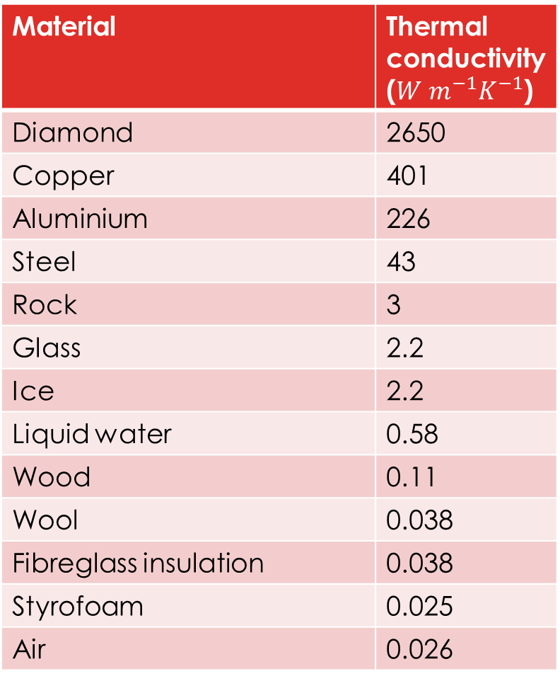
Conductors
Material | Thermal conductivity ($W m^{−1}K^{−1}$)
Diamond | 2650
Copper | 401
Aluminium | 226
Steel | 43
Rock | 3
Glass | 2.2
Ice | 2.2
Liquid water | 0.58
Wood | 0.11
Wool | 0.038
Fibreglass insulation | 0.038
Styrofoam | 0.025
Air | 0.026
Not all materials conduct heat at the same rate
Conduction is the dominant heat transfer method in solids, much smaller effect in fluids
Faster in materials with more rigid bonds between particles

Slide 49
Convection
Transfer of heat by fluids
Heat energy transported by moving particles
Very effective at transporting heat
Can function over enormous distances
See slides 16,17,19

Slide 50
Free vs Forced Convection
Free convection:
As a material is heated the particles gain E_{K} and E_{P}, as they are gaining E_{P} they move further apart, the material lowers in density, this effect is strong in fluids
In fluids, the regions of low density are free to rise due to buoyancy, so high temperature pockets of fluid will rise and low temperature pockets of high density fluid will sink
This sets ups convection currents which transport heat upwards in bodies of fluids
Forced convection:
Fluids driven by fans or pumps, can be in any direction
Used in cooling systems for machines

Slide 51
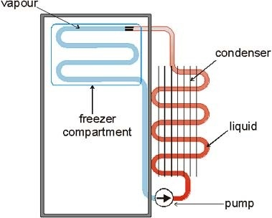
Fridges
Freezer compartment placed at top of fridge
Cold air from the cooling element sinks to cool the rest fo the fridge
Warm air from below rises to be cooled

Slide 52
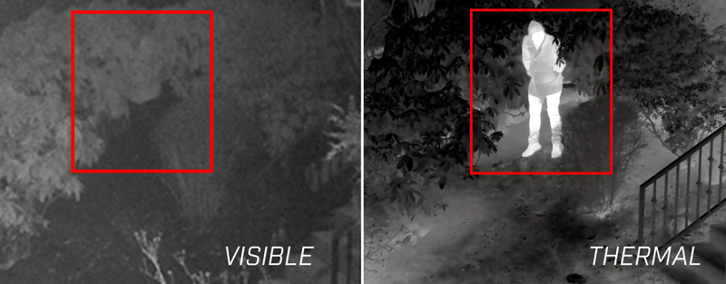
Radiation
Transfer of heat by electromagnetic waves
No matter required so heat can be transferred through a vaccum
Any object above absolute zero will emit radiation
The higher temperature of the object, the more radiation it will emit and the higher the frequency of the radiation

Slide 53
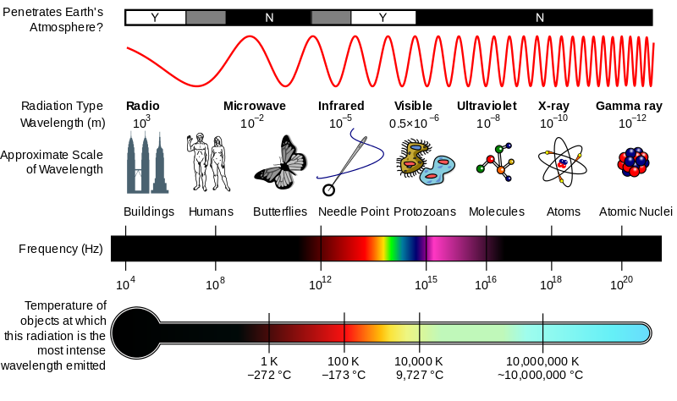
Electromagnetic radiation
Electromagnetic waves/photons
Travels at the speed of light in straight lines

Slide 54
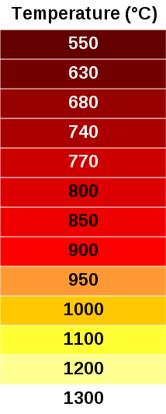

Incandescence
Most thermal radiation from objects around us occurs in the infrared part of the spectrum or below so it is not visible
Objects heat to around 550$℃$ and above start to emit visible light, this is known as incandescence

Slide 55
Emission and Absorbtion of radiation
A good emitter is a good absorber, a poor emitter is a good reflector
Darker coloured objects are better absorbers/emitters
Rough surfaces are better absorbers/emitters (greater surface area)
A rough black object will heat fastest in the sun but it will also cool fastest in the shade

Slide 56
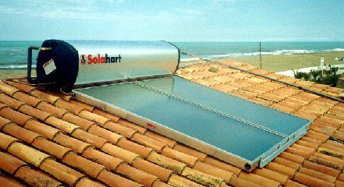
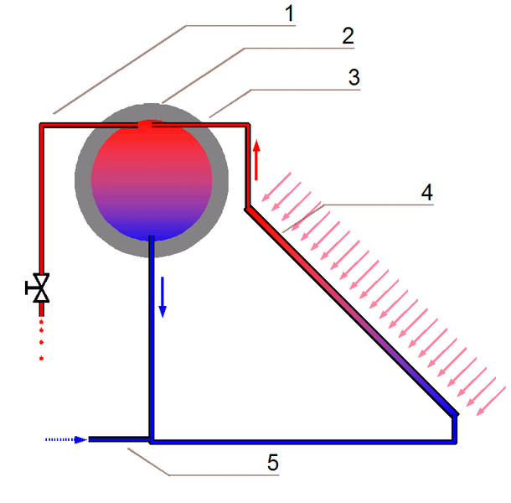
Solar hot water heater
Passive water heating system, no pumps, heating elements etc.
Hot water drawn from very top of the reservoir where it will be concentrated due to free convection
Silver body to reduce heat loss from radiation
Free convection causes heated water to flow through the panel to the reservoir
Glass covered panel (prevents heat loss by convection) filled with long coils of black pipes (increase heat gain by absorption)
Cold water added to system at the lowest point

Slide 57
Fridge
At the top of the fridge the liquid fluid passes through an expansion valve and evaporates, absorbing the latent heat of vapourisation and cooling the fridge
The cooling of the air at the top of the fridge establishes convection currents that cool the whole fridge
Outside the fridge the gas is compressed to make a hot gas, this is passed through the condenser, releasing the latent heat of vapourisation as it becomes a liquid
The net result is that heat is moved from inside the fridge to outside the fridge

Slide 58
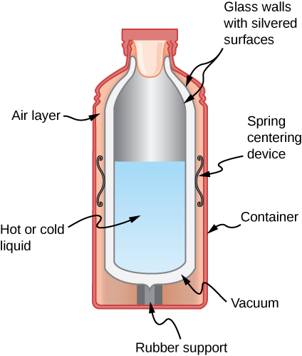
Vacuum flask (thermos flask)
Core device is made of 2 layers of silvered glass with a vacuum between the layers
Glass is a poor conductor
conduction and convection can’t occur through the vacuum
The silvering minimises transfer of heat by radiation
Very minimal heat flow into or out of the flask

Slide 59
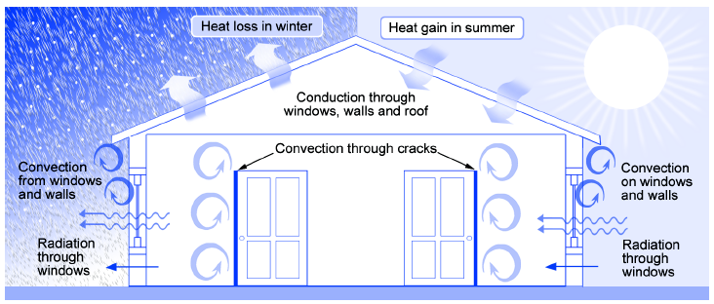
Houses
Often advantageous to block heat transfer into/out of a home
Most methods trap pockets of air which is a poor conductor and can’t convect when trapped
Double glazed windows
Ceiling batts
Wall cavity insulation

